Slide 1

Big Data Analysis Project
BDA Course – Technion
Marina Klipach * Tamir Edelstein

Slide 2

Book Crossing Dataset
The Book Crossing Dataset contains information about 278,858 users (anonymized but with demographic information) providing 1,149,780 ratings (explicit / implicit) about 271,379 books.
The dataset was collected in August and September 2004.
1

Slide 3




Work Process
Import the CSV Data files
Create star scheme
Using Tableau Prep
Transform and processes the Data
Data Analytics
Using Google Colab notebook
Using Tableau Desktop
2

Slide 4



The data prep process
Using Google Colab notebook
Spark environment
Ratings file
Books file
Users file
Data cleaning
Check Null Values
Check duplicates
Data cleaning
Check Null Values
Check duplicates
Drop Unnecessary columns.
Replace illogical books publication years.
Coping with the ISBN that doesn’t exist in a book table but exit in the rating table.
Data cleaning
Split the Location column.
Check Null Values
Check duplicates
Replace illogical users ages.
Using Pycountry to identify the country of the registered users.
2

Slide 5
Data Analytics
Using Tableau Desktop
2

Slide 6
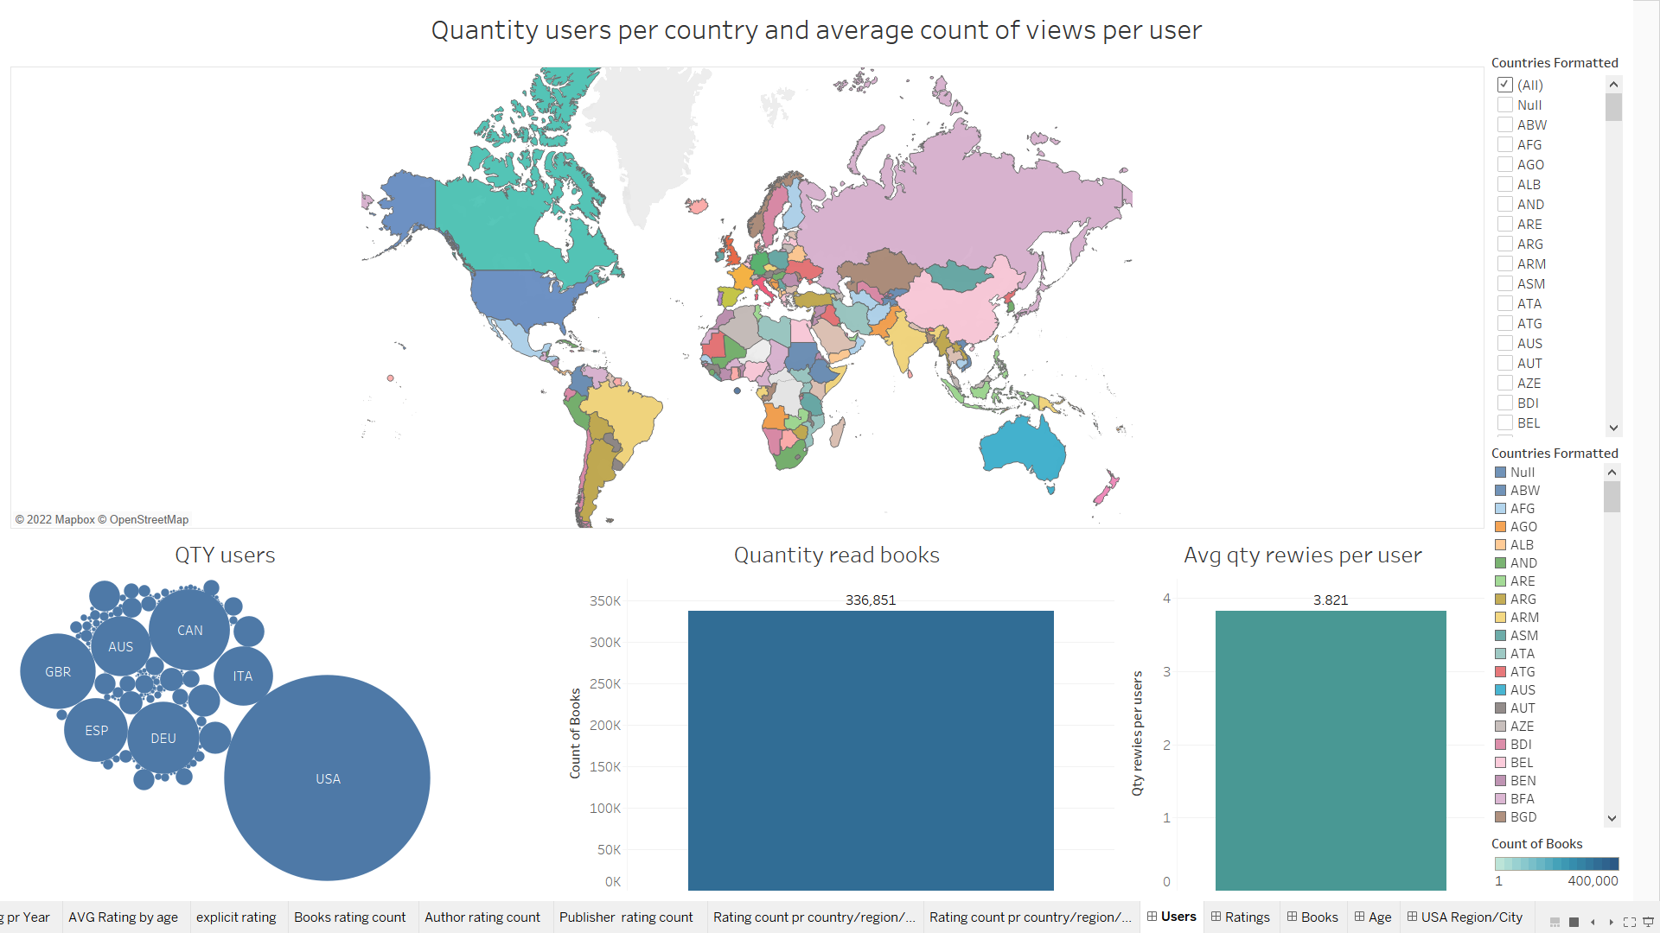

Slide 7
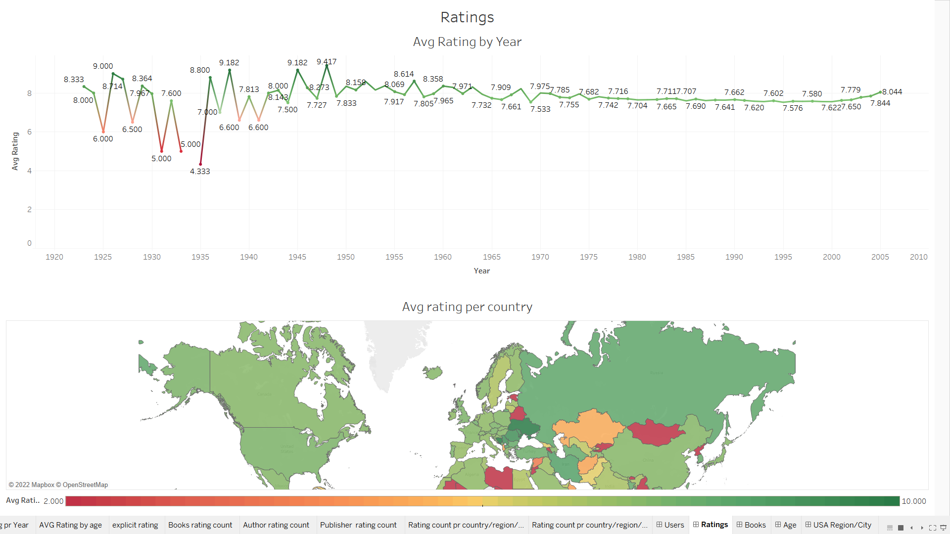

Slide 8
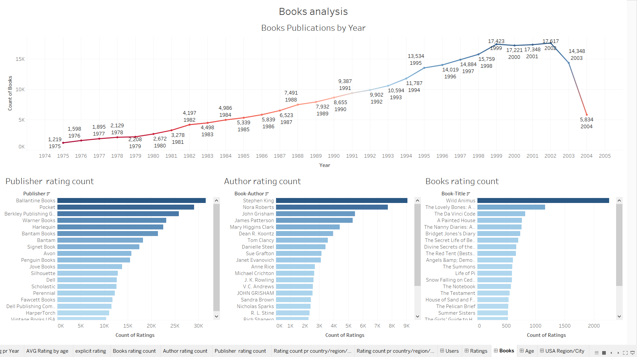

Slide 9
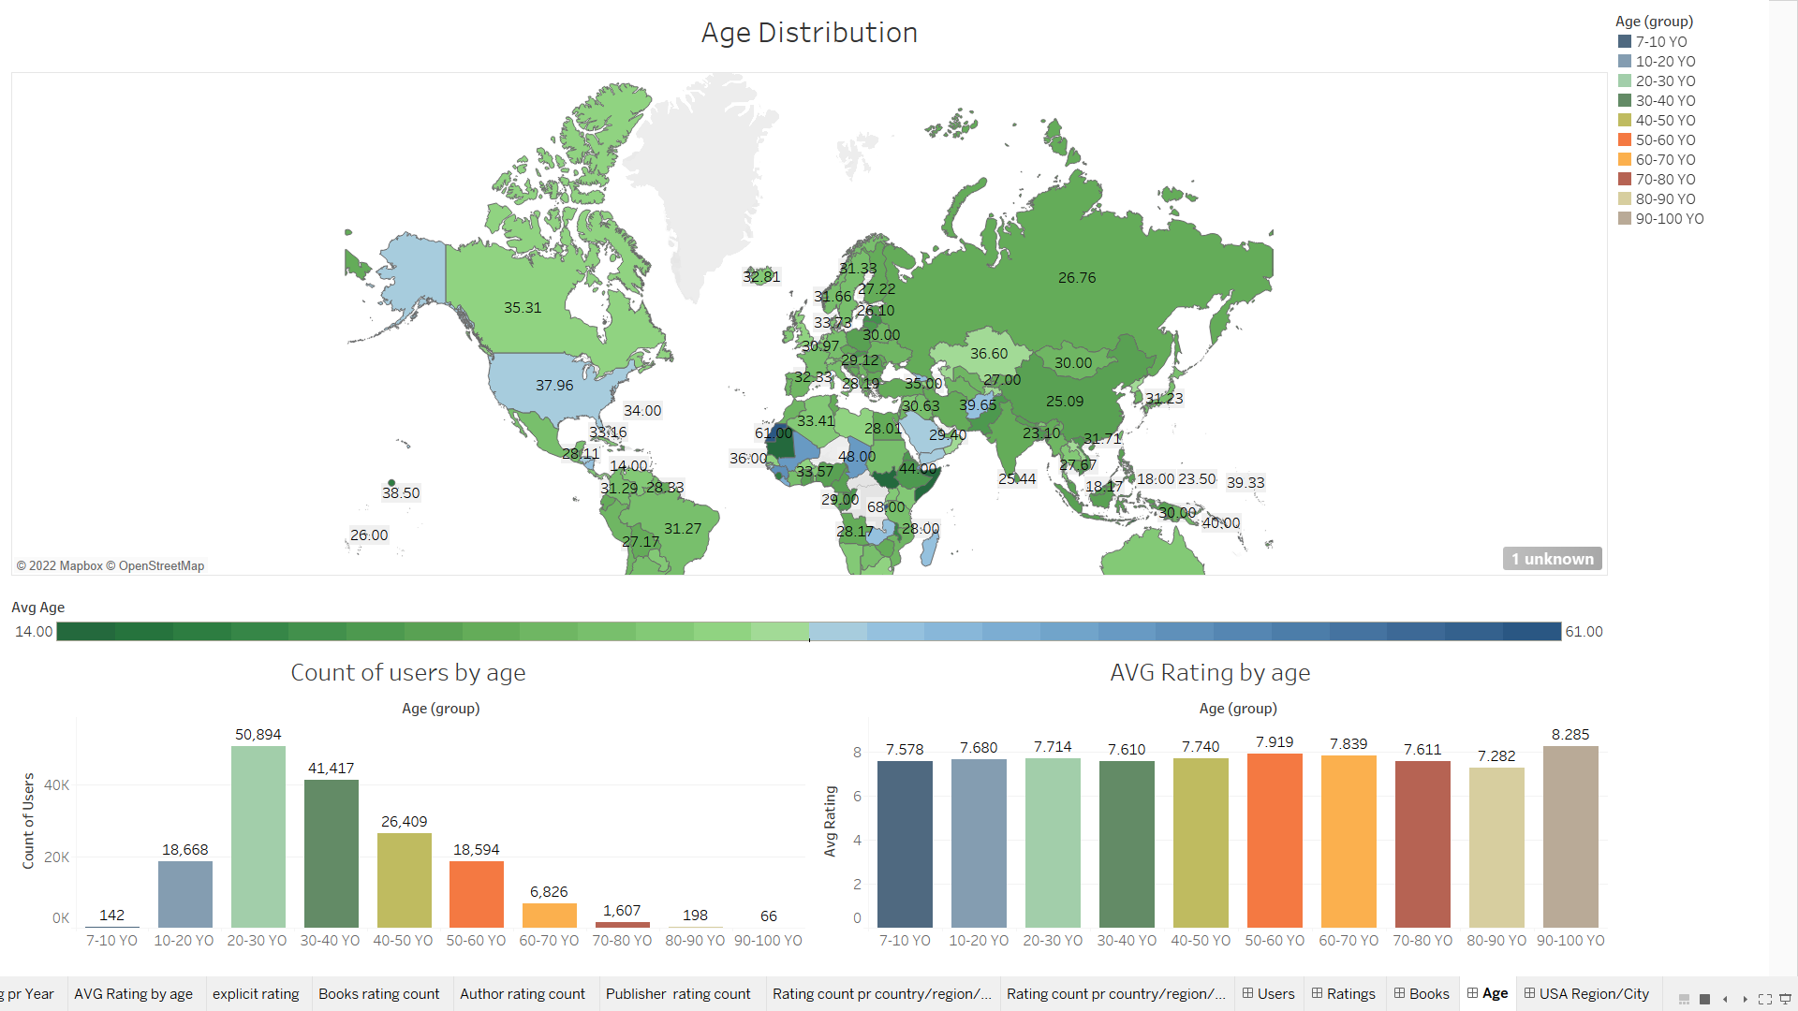

Slide 10
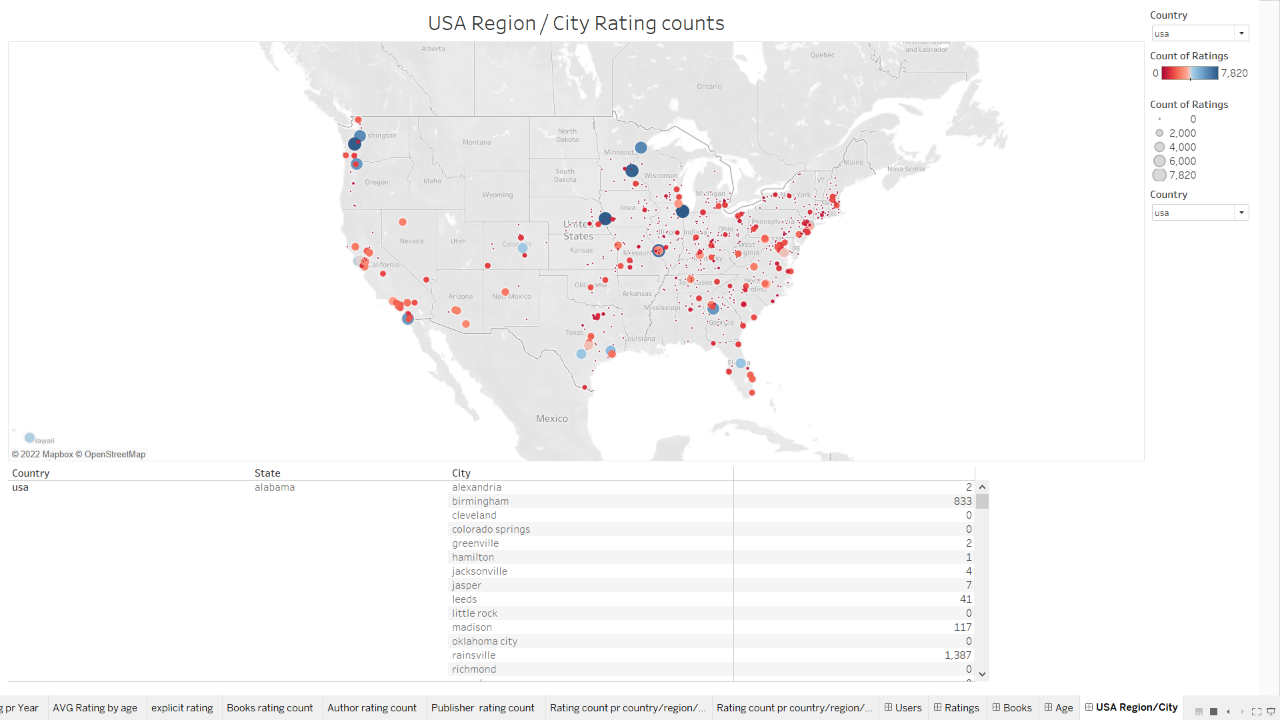

Slide 11
THANK
YOU
BDA Course – Technion
Marina Klipach * Tamir Edelstein

